Slide 1
Universal Approximation
Implementation on a qubit

Slide 2
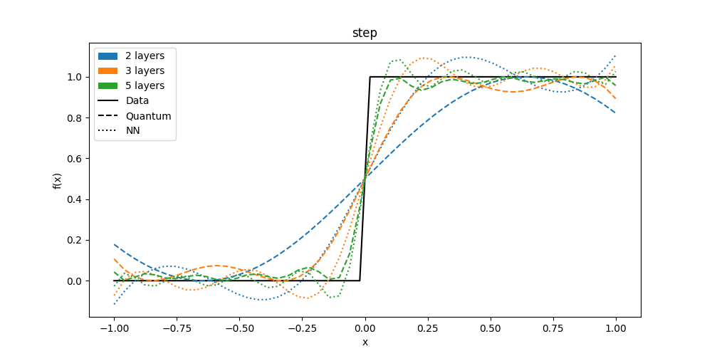
Step function

Slide 3
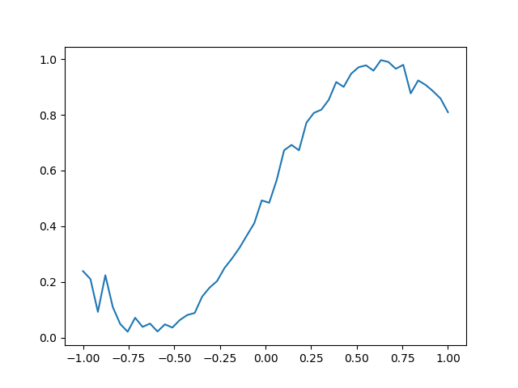
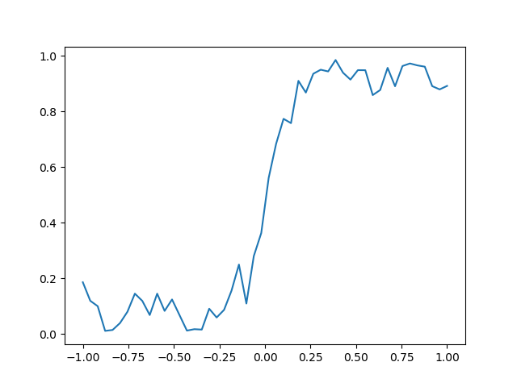
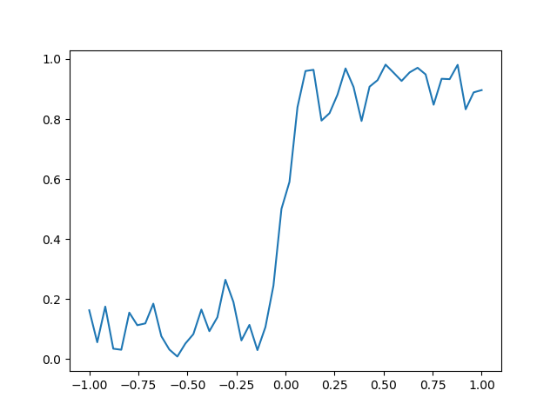
Step function - Simulation
2 LAYERS
3 LAYERS
5 LAYERS

Slide 4
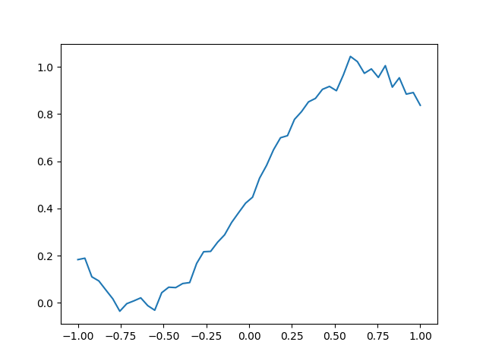
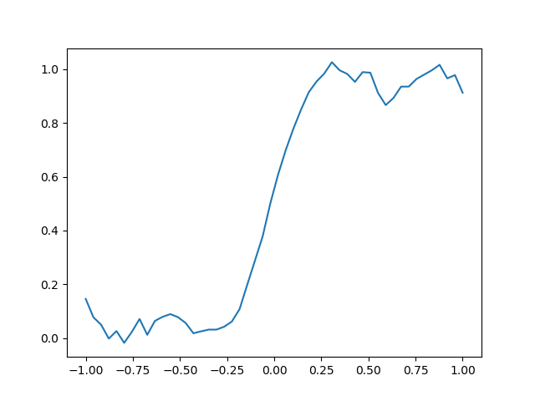
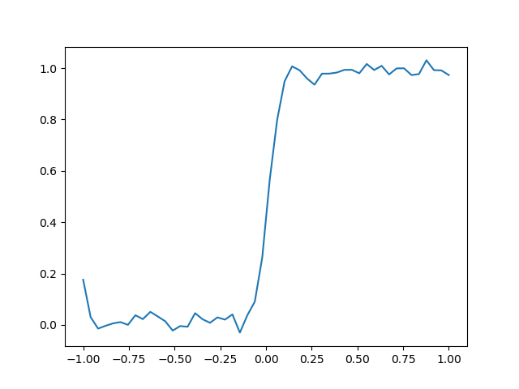
Step function - Experiment
2 LAYERS
3 LAYERS
5 LAYERS

Slide 5
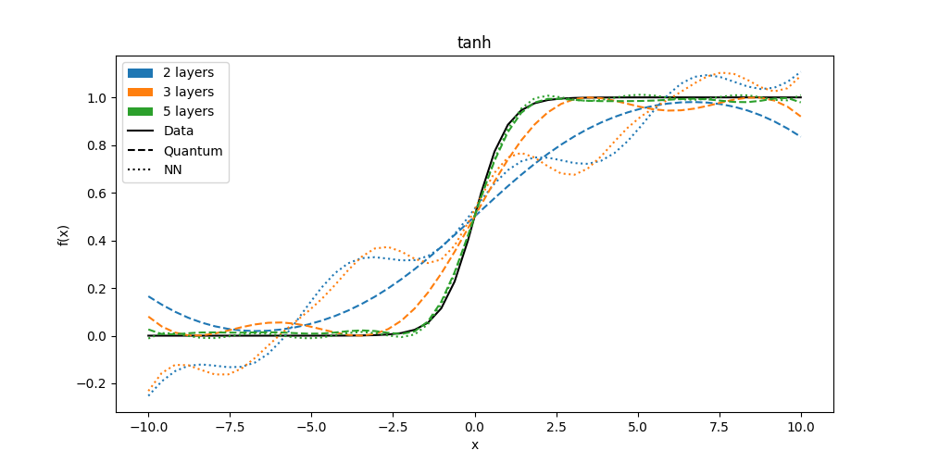
Tanh function

Slide 6
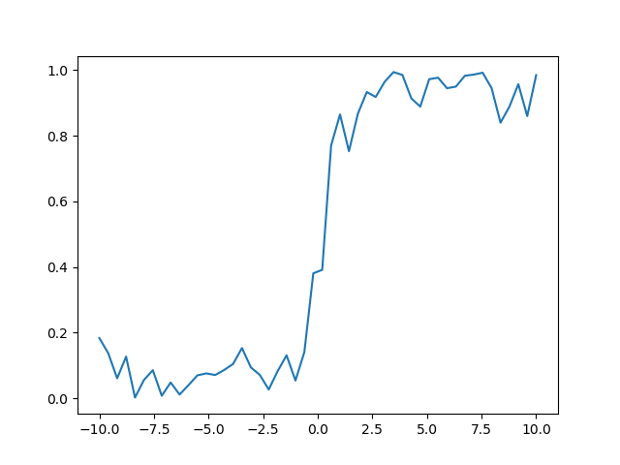
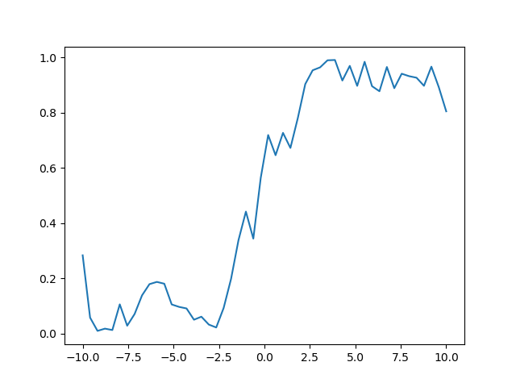
Tanh function - Simulation
2 LAYERS
3 LAYERS
5 LAYERS

Slide 7
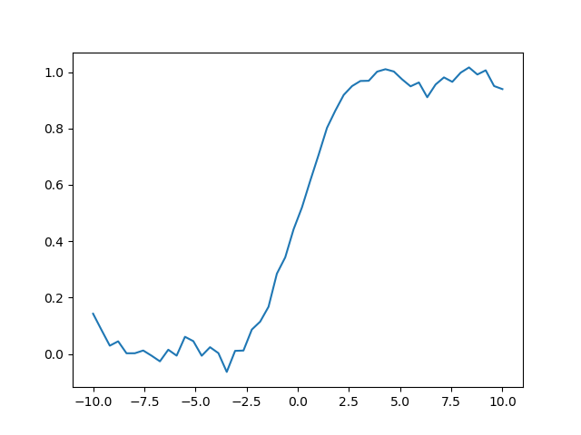
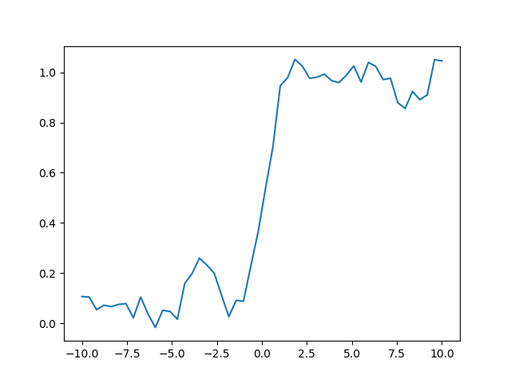
Tanh function - Experiment
2 LAYERS
3 LAYERS
5 LAYERS

Slide 8
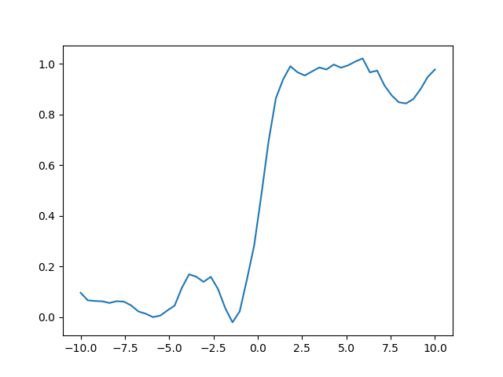
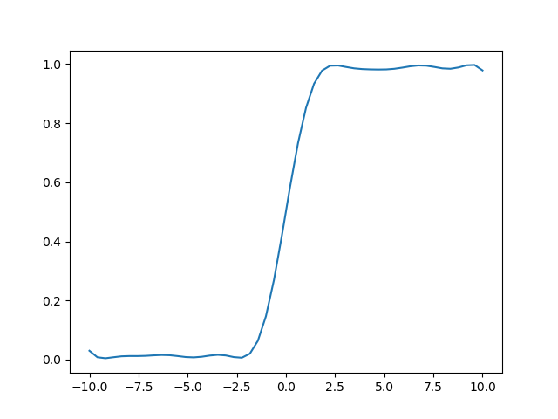
Tanh function – Experiment 5 layers
Default trial
More averages
Simulation no noise

Slide 9
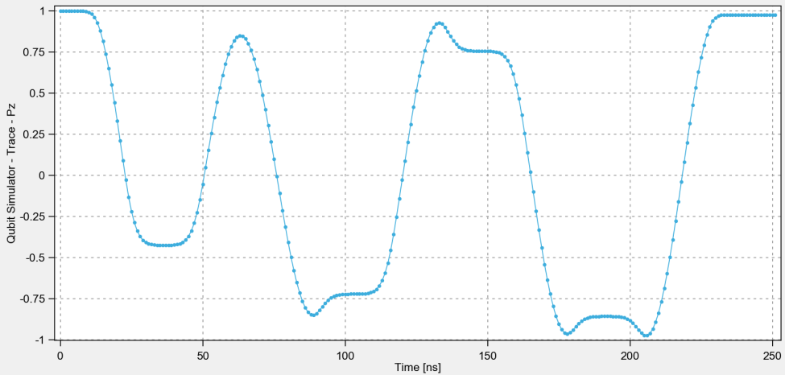
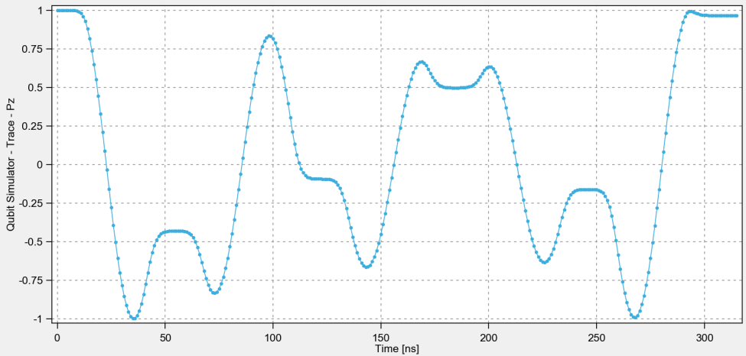
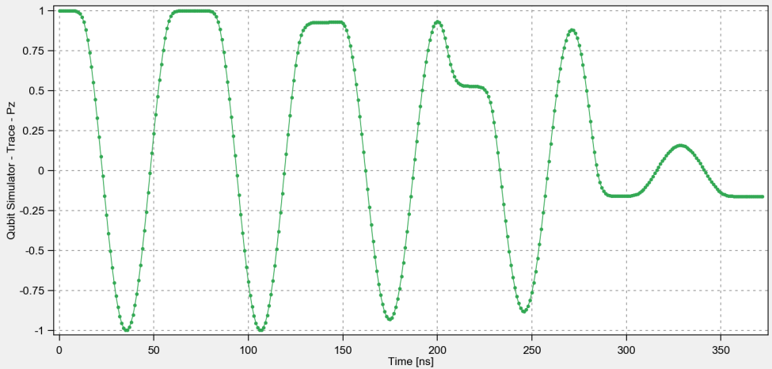
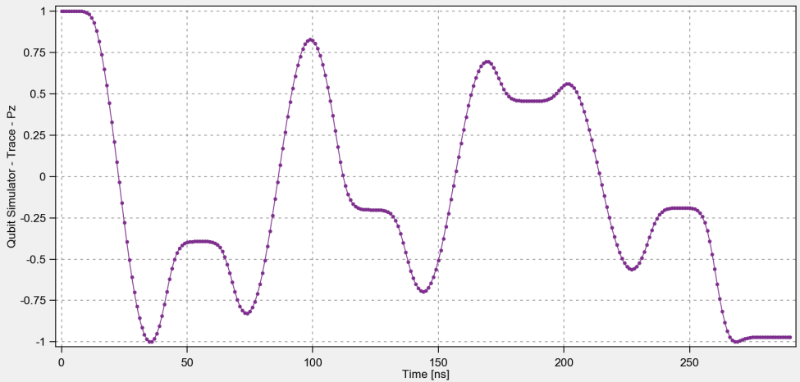
Tanh function – Trace evolution
X = -7
X = -3
X = 0
X = 8

Slide 10
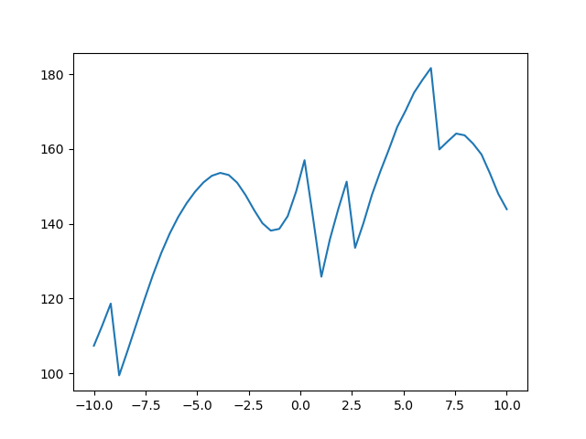
Tanh function – Time out of ground state

Slide 11
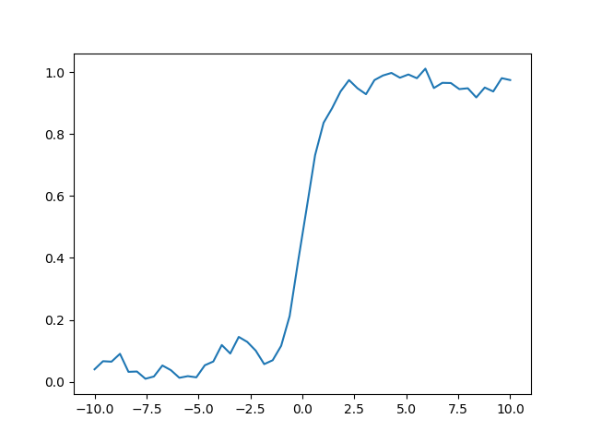
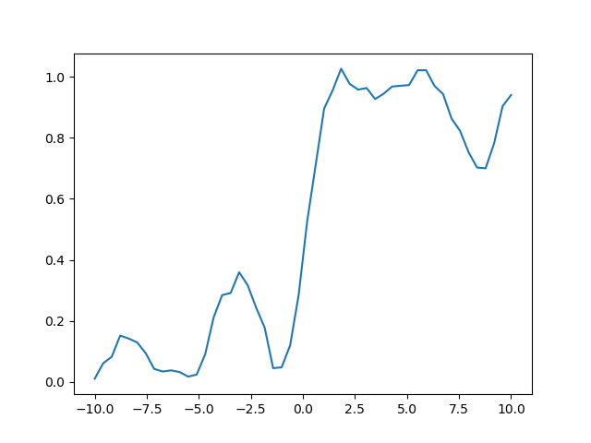
Tanh function – Exp5L – Changing Spacing
Default trial: sp=20n
No spacing
More spacing: sp=50n

Slide 12
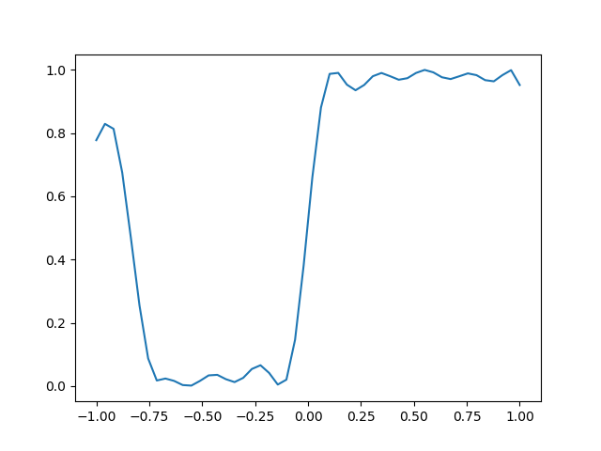
Step function – No-noise sim & more averages
NO NOISE
MORE AVERAGES
THEORY

